Slide 1

Multi Terrain Locomotion of Basilisk Lizard Inspired Robot
Nitish Thatte
Mahdi Khoramshahi

Slide 2

Tail
Foot forces create moment about COM
Moment can be balanced by tail

Slide 3
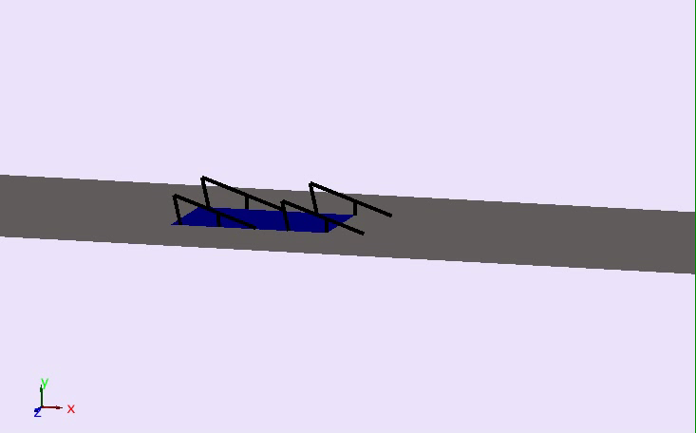

Slide 4
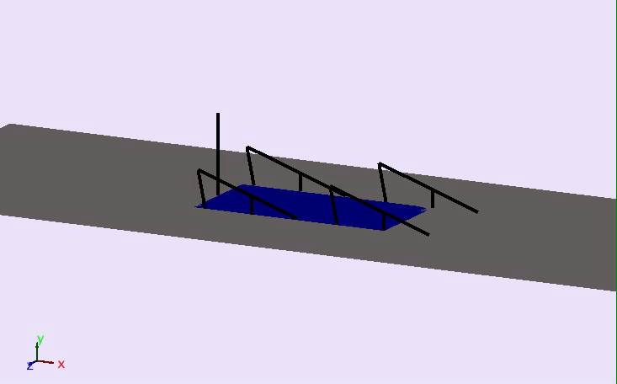

Slide 5
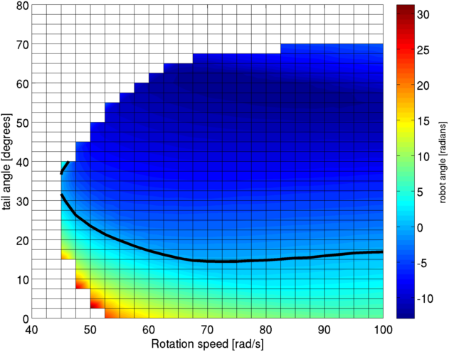
Robot Angle vs. Leg Rotation Speed and Tail Angle
Notes:
50 – 70 rad/s is likely use zone
17.5 degrees +- 5
Robot doesn’t sink at most speeds

Slide 6
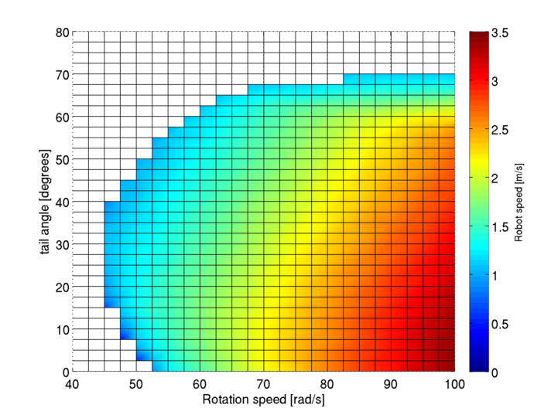
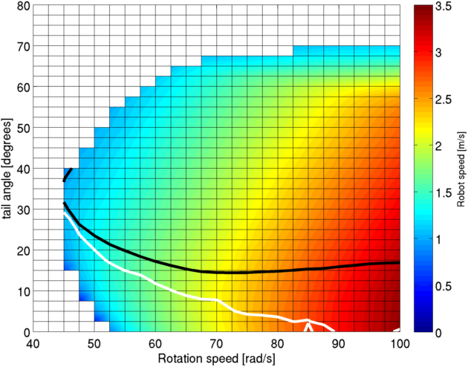

Robot Speed vs. Leg Rotation Speed and Tail Angle

Slide 7
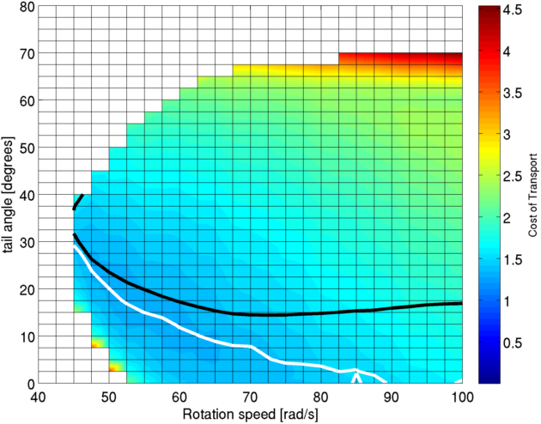
COT vs. Leg Rotation Speed and Tail Angle

Slide 8
How Else Can We Control Pitch Angle?
Force generated from fluid drag is proportional to (foot velocity)²
Moving foot faster during plunge stage than retraction stage should generate more lift
Controlling plunge and retract speeds of each leg individually will impart moments on the robot body.
Air Cavity
Water
JW Glasheen and TA McMahon. Vertical water entry of disks at low Froude numbers. Physics of Fluids, 8(8):0–5, 1996.

Slide 9
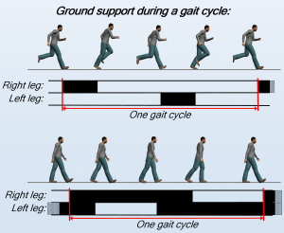
Duty Factor
A general principal:

Slide 10
Duty Factor
Motion is determined give parameters: $ω and D$
and switching angle

Slide 11
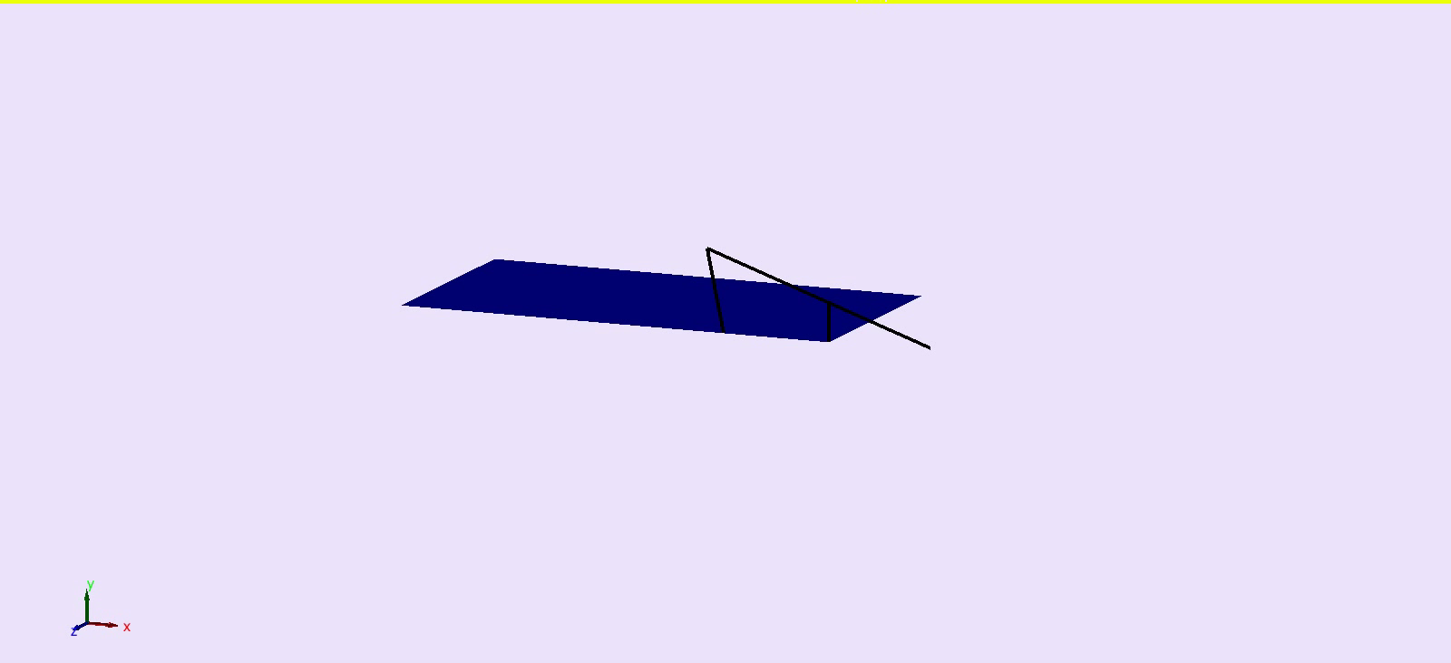

Slide 12
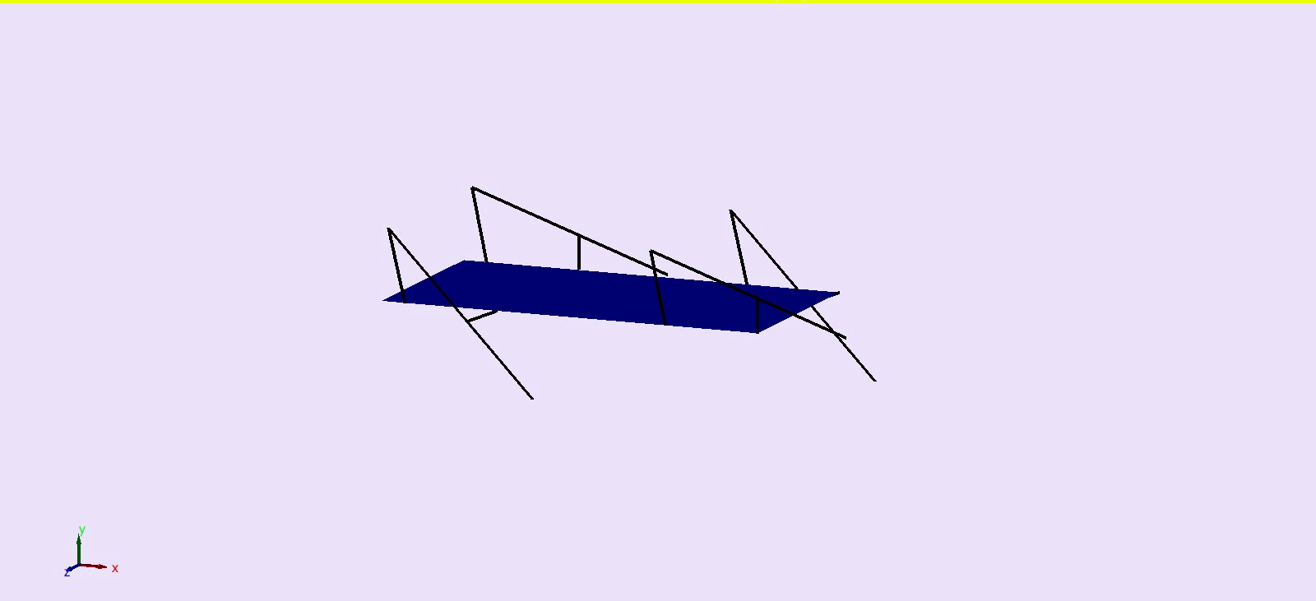

Slide 13
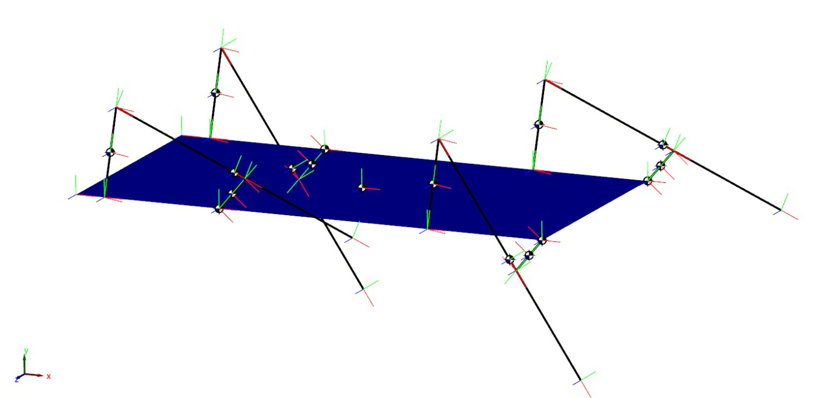
Using Different DFs per Leg

Slide 14
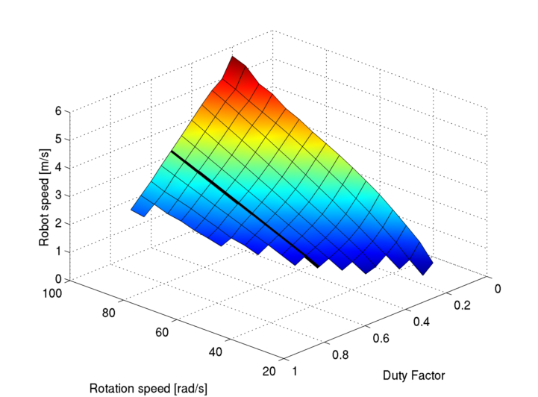
DF and Rotation Speed vs. Robot Speed

Slide 15
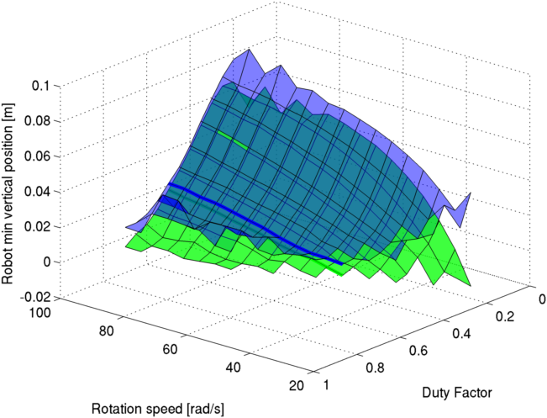
DF and Rotation Speed vs. Robot Height

Slide 16
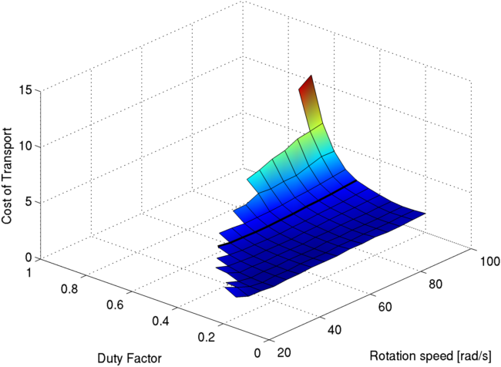
DF and Rotation Speed vs. Robot Speed

Slide 17
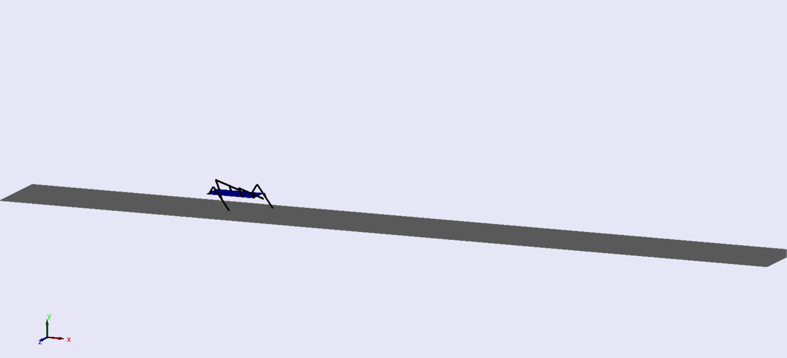
Stable gait with pitch restriction

Slide 18
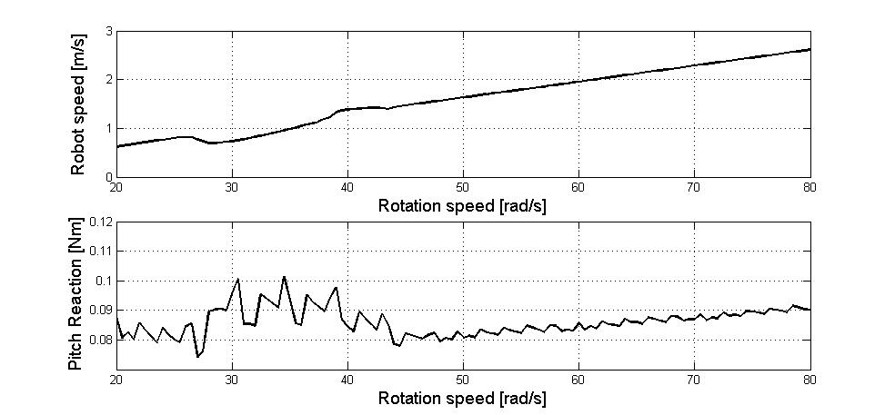
Torque reaction on COG while pitch is restricted

Slide 19
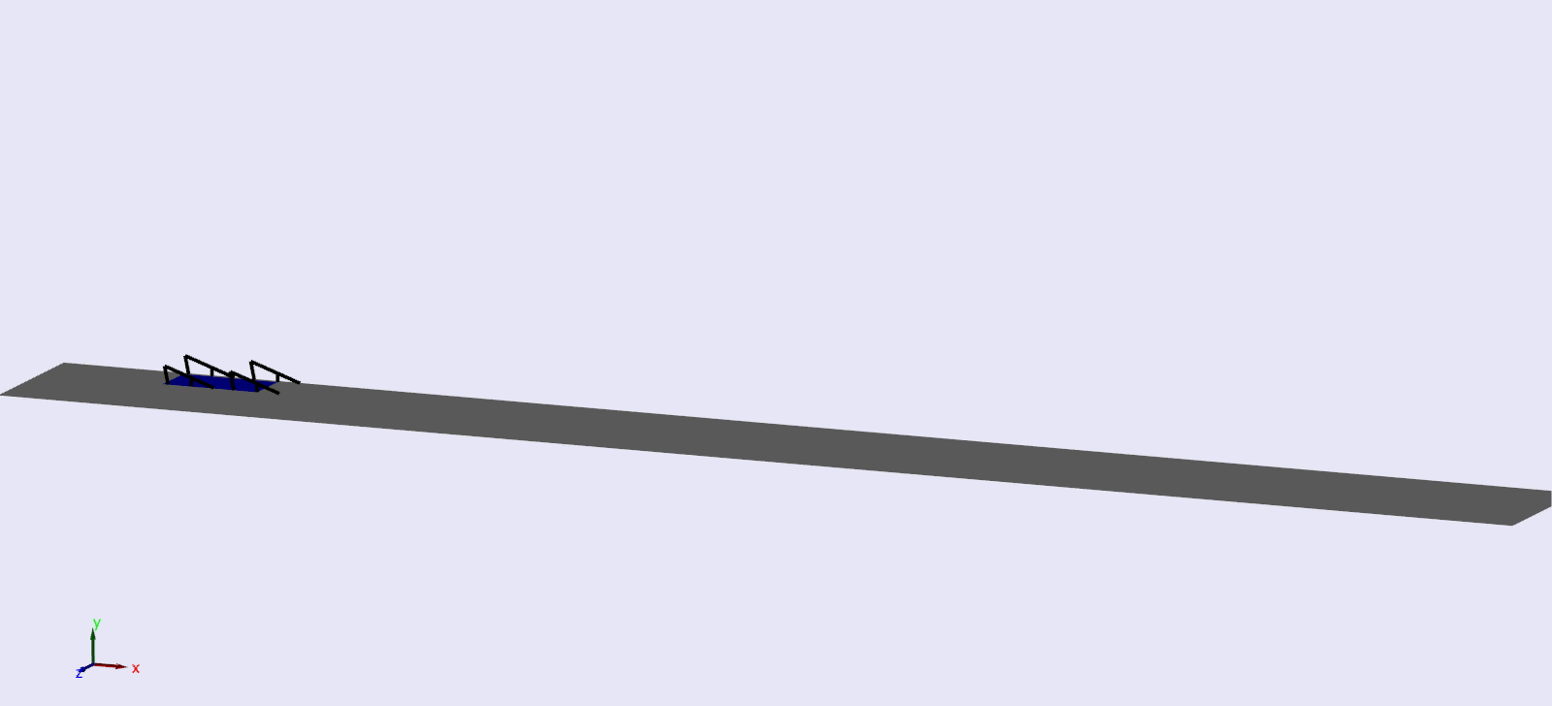

Slide 20
COG has been moved forward 20% of body length

Slide 21
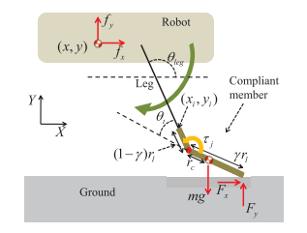
Ground Locomotion with Compliance
Compliance allows foot to store KE as PE during “heel strike”
PE → KE during “toe off”
More elastic collision reduces energy loss
Foot deflection dynamics [3]
Improved ground contact model from Hartmut Geyer’s Lab
HS Park and Metin Sitti. Compliant footpad design analysis for a bio-inspired quadruped amphibious robot. Intelligent Robots and Systems, 2009. IROS . . . , pages 1–11, 2009.

Slide 22
Robot Speed vs. Leg Rotation Speed

Slide 23
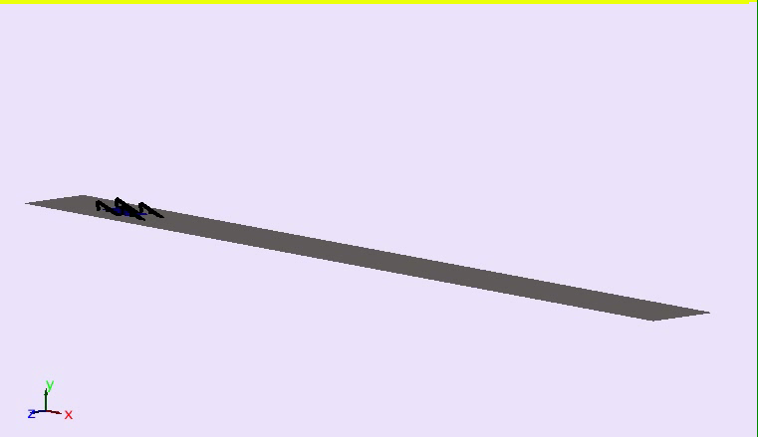

Slide 24
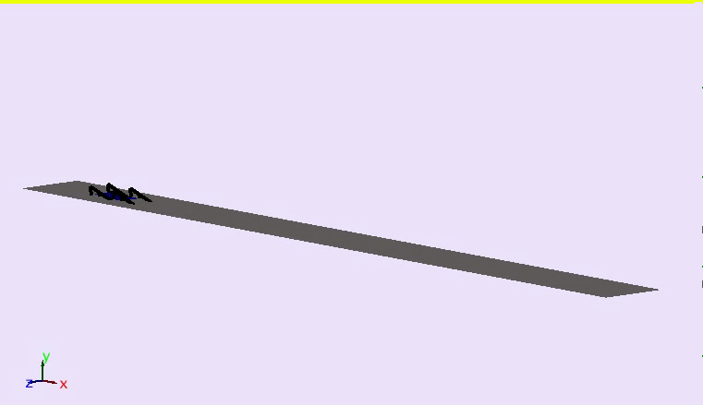

Slide 25
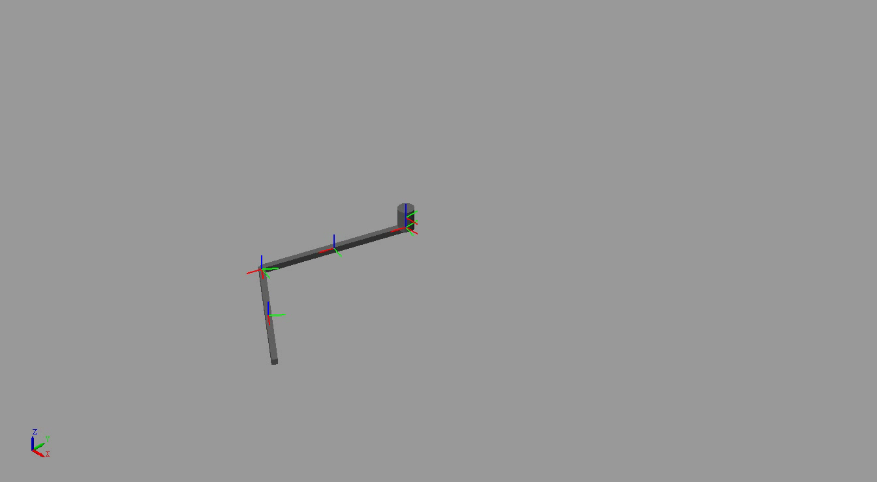
SimMechanics Second Generation

Slide 26
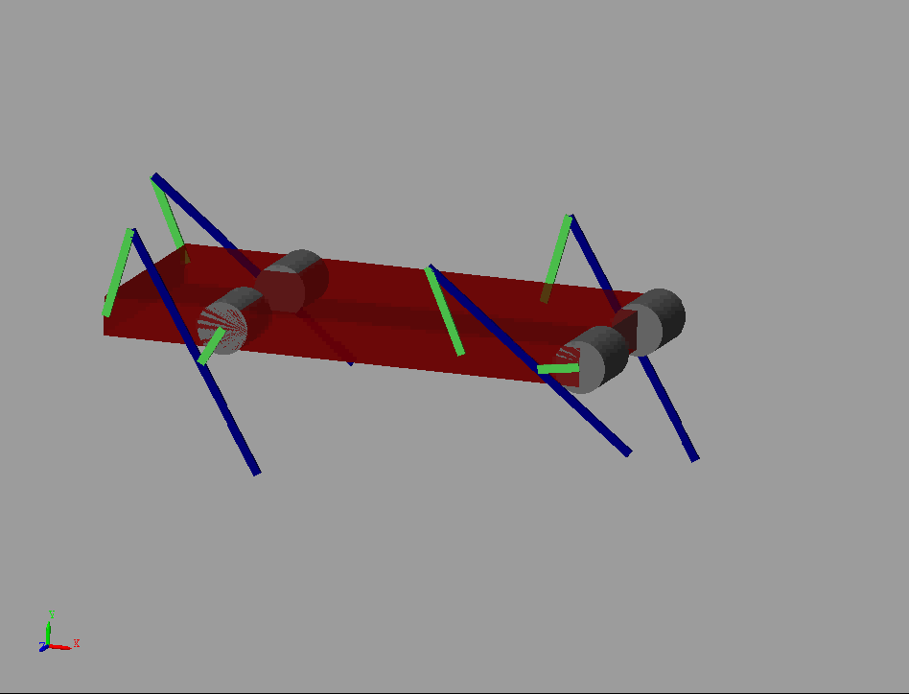

Slide 27
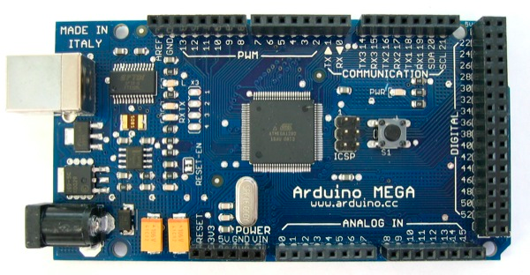
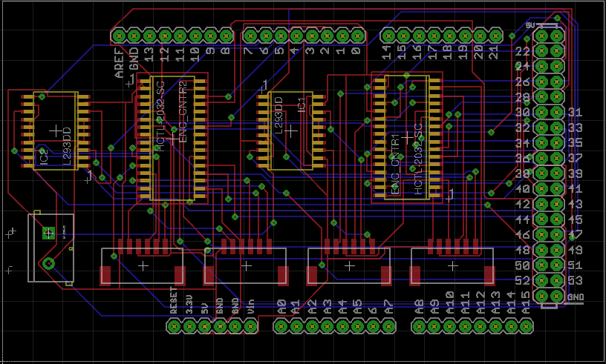
Electronics
Arduino Mega Microprocessor
Designed custom shield for Mega
Motor Drivers
L293DD
Encoder Counters
Avago HCTL-2032-SC
IMU connection
Onboard Electronics/Actuators
Optical Relative Encoders
GM14a Motors
IMU (Sparkfun?)

Slide 28
Data Flow
Simulink
Arduino
Shield
IMU
Low Level Control
Data Acquisition
Encoder Counters
Motor Drivers
Sensors/Drivers
High Level Control
Robot
Physical System

Slide 29

Future Work
Finish constructing SimMechanics 2G model
Repeat simulations using Simmechanics 2G for verification
Especially Motor Dynamics
Import CAD models for better visualization
Gait control using Per-Leg Duty Factor
Mapping from Robot State Duty factors
Control
Finish Circuit Board Design
Check connections
Pick IMU unit

